Slide 1

An Analysis of Food Security in USA - 2021
Akshay Verma, Aveline Mariya Shaji and Uugangerel Bold

Slide 2
Purpose of the research
To find out how different demographic and socioeconomic factors relate to food security.
To study the specific pattern shown in the data that affects food security such as states, family size, income level, SNAP usage, race, immigrant status, work status, education level.

Slide 3
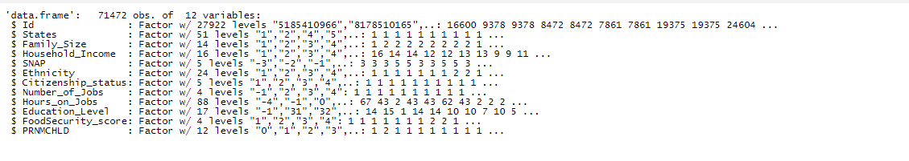
The Dataset
Source: Current Population Survey(CPS) by the US Census Bureau
The December 2021 CPS file contains 127,489 records.
Sample used for the study:

Slide 4
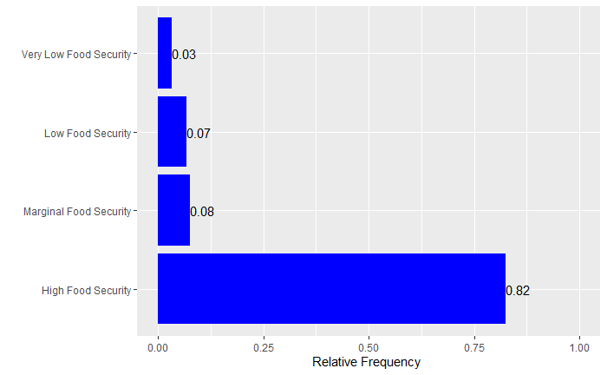
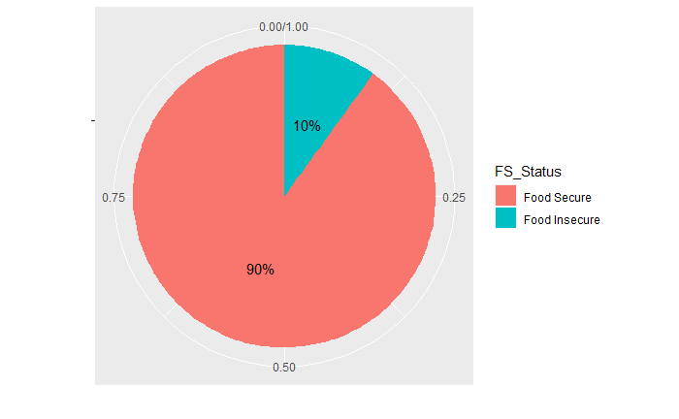
High Food Security: No reported indications of food-access problems or limitations.
Marginal Food Security : One or two reported signs, usually anxiety over food availability or scarcity in the home. There is little to no evidence that diets or food intake have changed.
Low food security: One or two reported signs, usually indicating worry about food scarcity or insufficiency at home. Little to no evidence of dietary or food intake changes.
Very low food security: reports of numerous signs of altered eating habits and decreased food intake.

Slide 5
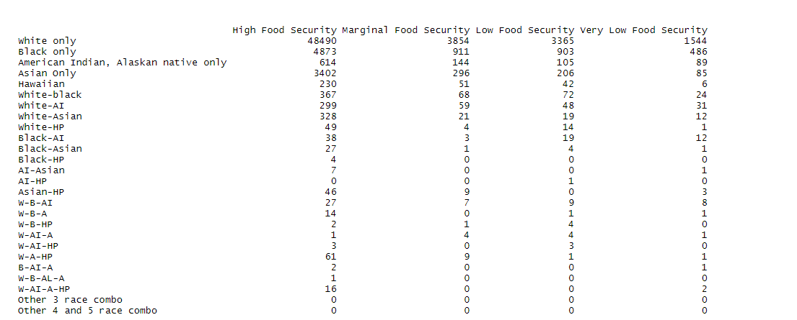
Ethnicity & Food Security

Slide 6
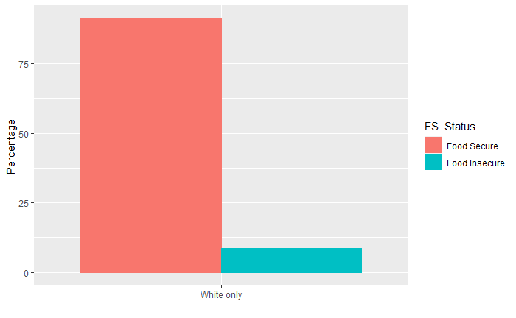
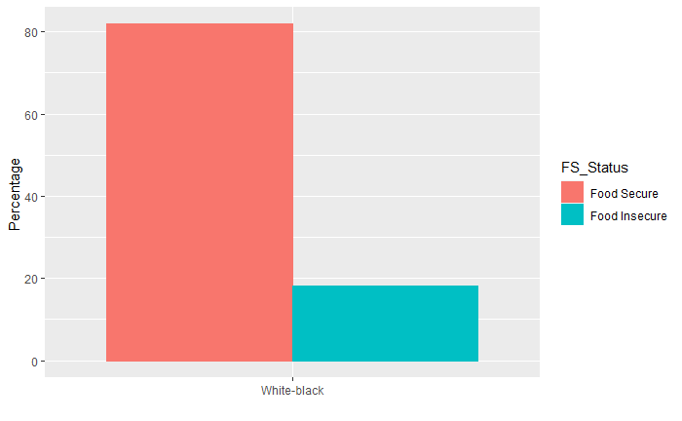

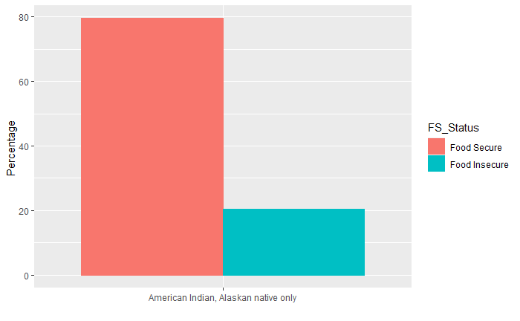

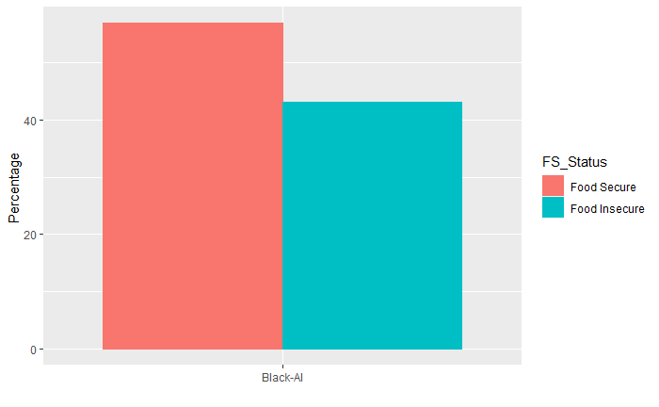

Slide 7
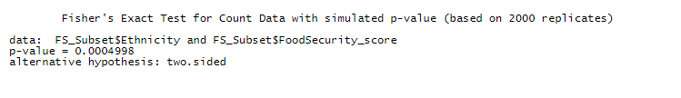
Hypothesis Testing b/w Ethnicity & Food Security Score
Using Fisher’s Exact Test instead of Chi-square test because of the many low frequency levels present.
Null Hypothesis is that the Ethnicity and Food Security Status are Independent of each other
Taking the alpha to be 0.05
Since, the P value is much less than the alpha. We can reject the null hypothesis and say that there is some relation between Ethnicity and Food Security Status

Slide 8
Food Security & Citizenship Status

Slide 9



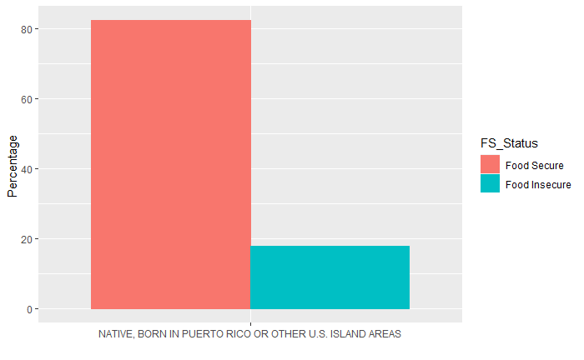
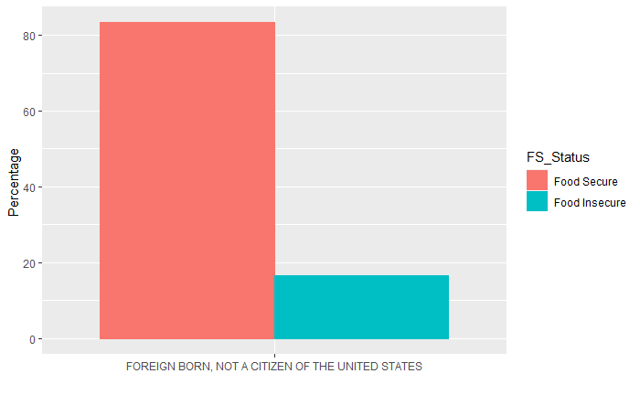

Slide 10

Hypothesis Testing b/w Citizenship & Food Security Score
Using Chi-Square Test
Null Hypothesis is that the Citizenship Status and Food Security Status are Independent of each other
Taking the alpha to be 0.05
Since, the P value is much less than the alpha. We can reject the null hypothesis and say that there is some relation between Citizenship and Food Security Status

Slide 11

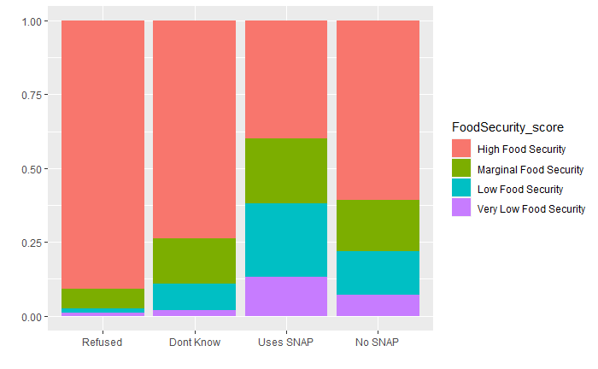
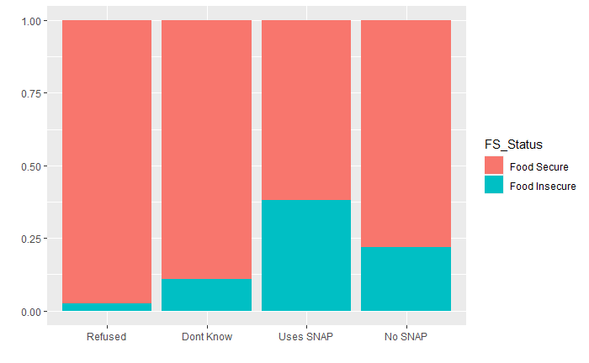
SNAP & Food Security

Slide 12
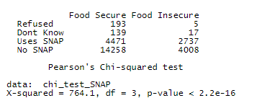
Hypothesis Testing b/w SNAP & Food Security Score
Using Chi-Square Test
Null Hypothesis is that the SNAP and Food Security Status are Independent of each other
Taking the alpha to be 0.05
Since, the P value is much less than the alpha. We can reject the null hypothesis and say that there is some relation between the SNAP and Food Security Status

Slide 13
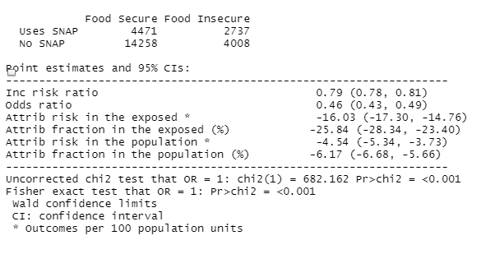
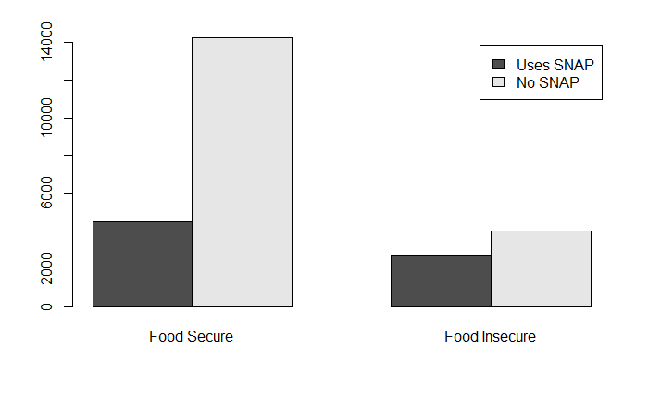
Odds Ratio between people in and not in SNAP
Odds Ratio is 0.46
This means that the odds of a person not on SNAP to be food secure is 2.17 times the odds of person on SNAP to be food secure

Slide 14
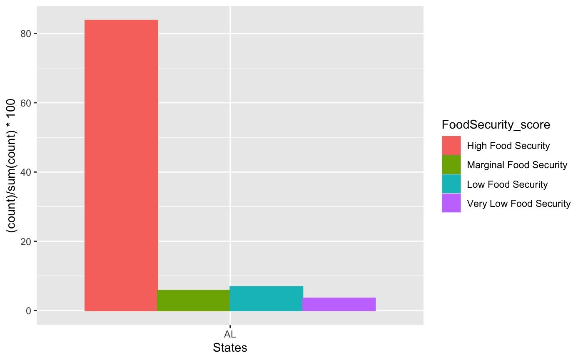
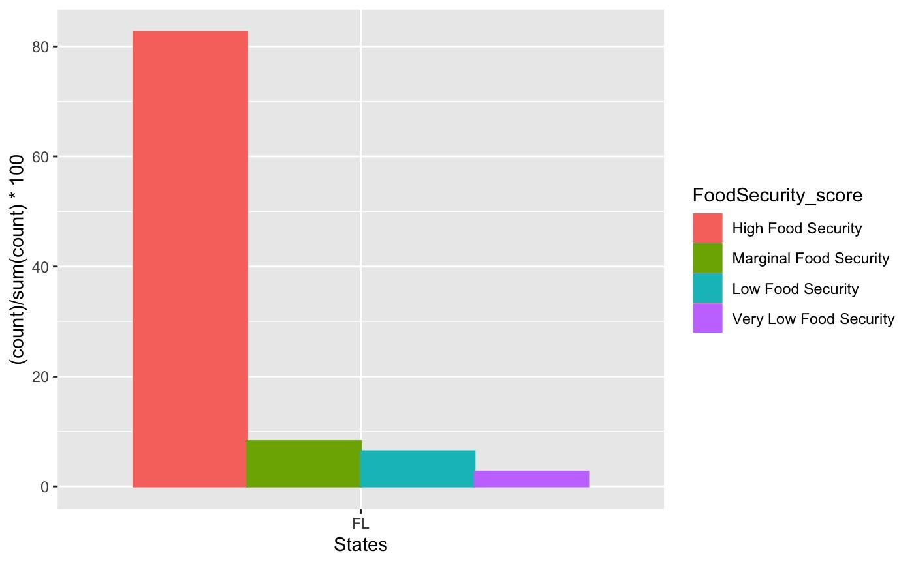

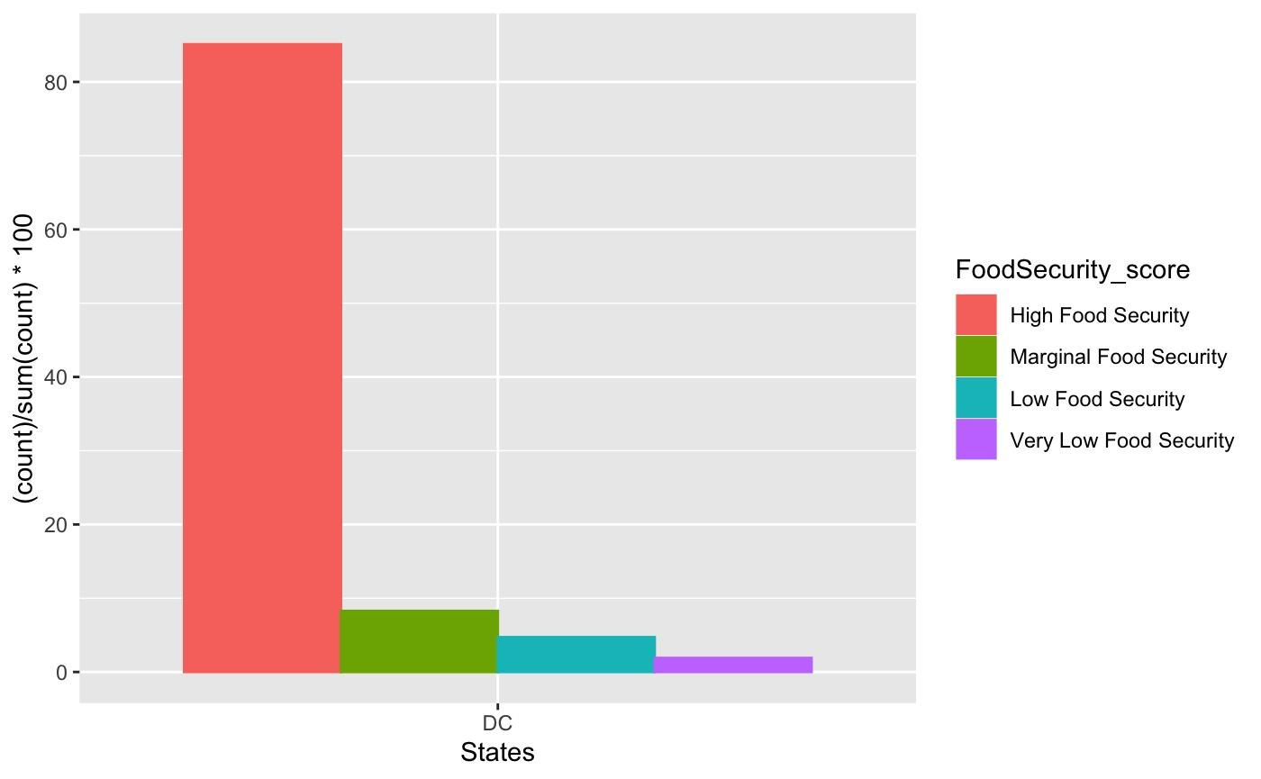


States vs Food security
In overall, California has the highest number of respondents (6975), whereas Maine has the smallest number of respondents (564). In order to compare, we’ve chosen states which have similar number of respondents.
Alabama 1207 vs Washington DC 1207, Florida 2738 vs New York 2580, IL 2052 vs PA 1928.

Slide 15
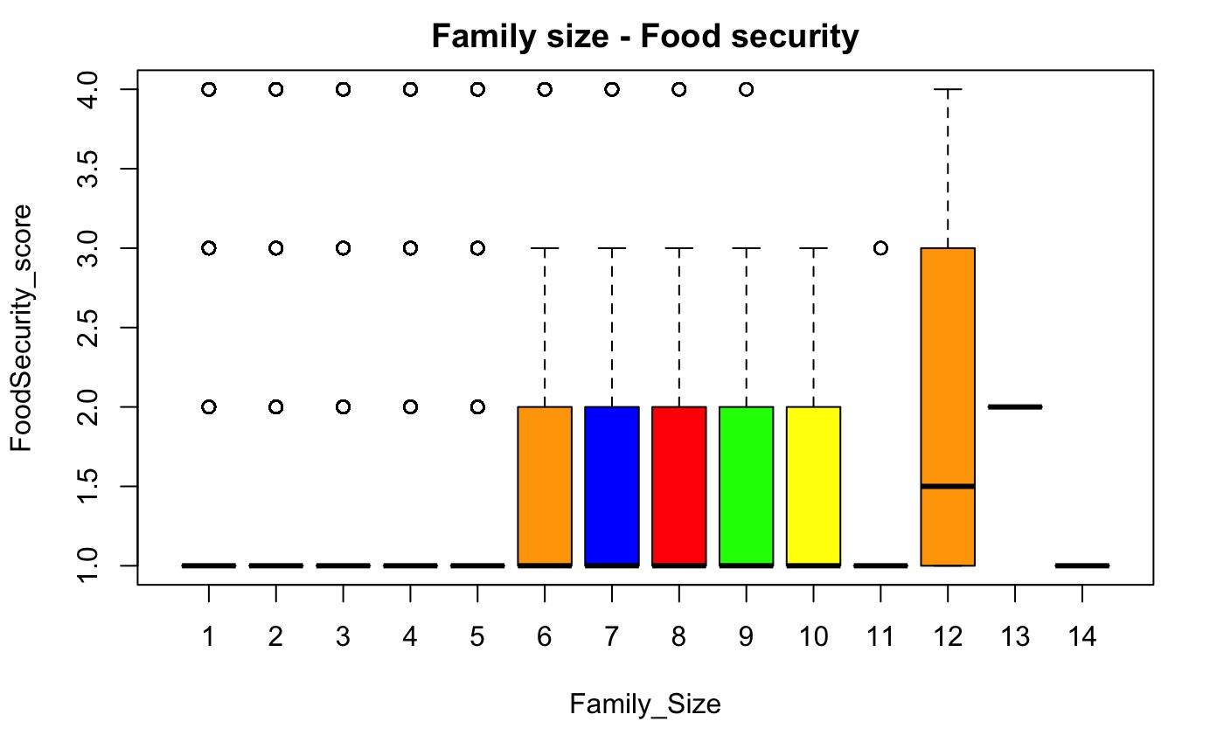
Majority (21816) of the families have 2 members.
Next big groups are 3-members (12753) and 4-members (13724) households.
Pearson's Chi-squared test
data: family_t
X-squared = 1691.7, df = 39, p-value < 2.2e-16
Reject the null hypothesis
Relation between the Family size and Food Security Status

Slide 16
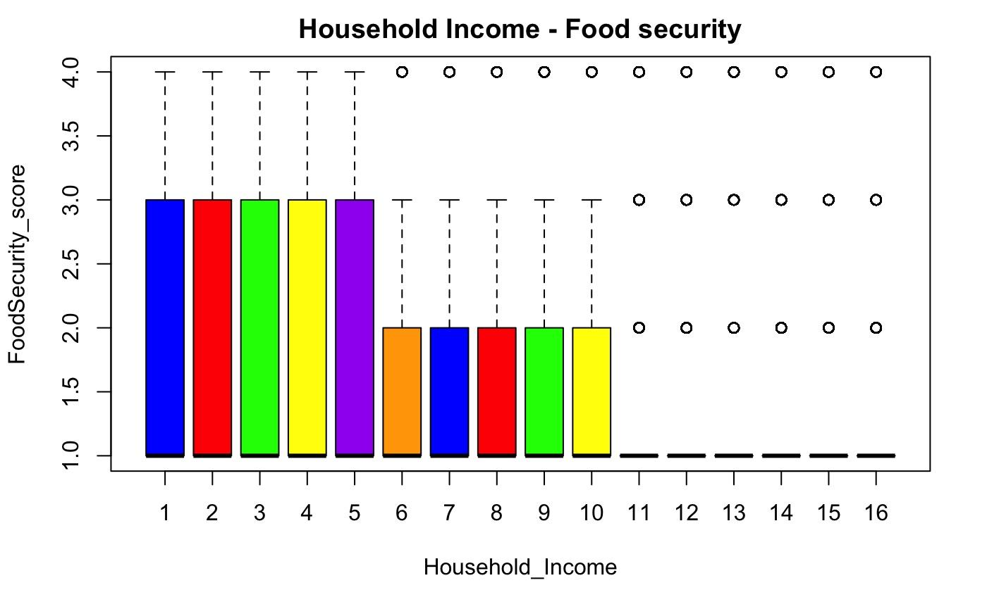
1 LESS THAN $5,000
2 5,000 TO 7,499
3 7,500 TO 9,999
4 10,000 TO 12,499
5 12,500 TO 14,999
6 15,000 TO 19,999
7 20,000 TO 24,999
8 25,000 TO 29,999
9 30,000 TO 34,999
10 35,000 TO 39,999
11 40,000 TO 49,999
12 50,000 TO 59,999
13 60,000 TO 74,999
14 75,000 TO 99,999
15 100,000 TO 149,999
16 150,000 OR MORE
Reject the null hypothesis
Relation between the Household income and Food Security Status
Pearson's Chi-squared test
data: income_t
X-squared = 9512.9, df = 45, p-value < 2.2e-16

Slide 17
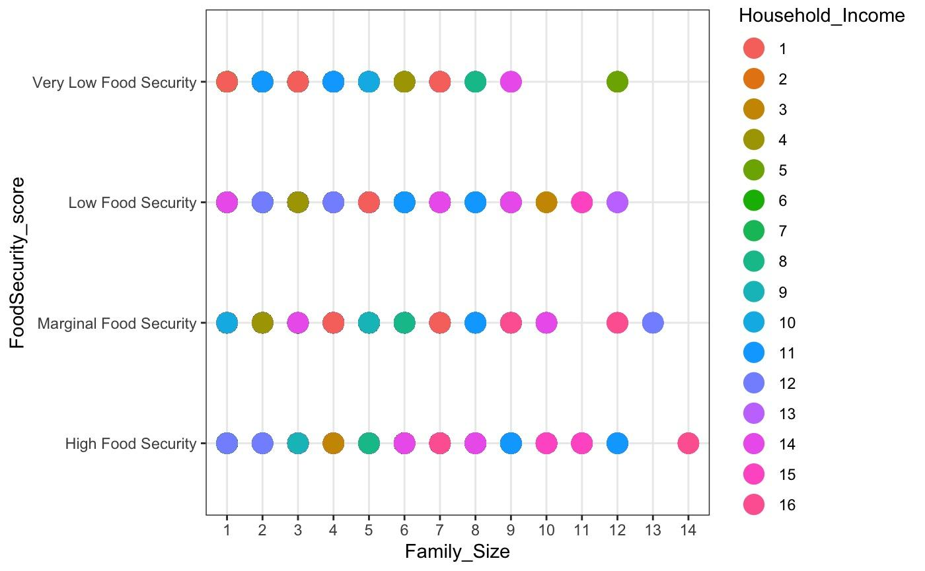
Family size vs Household income vs Food security score

Slide 18
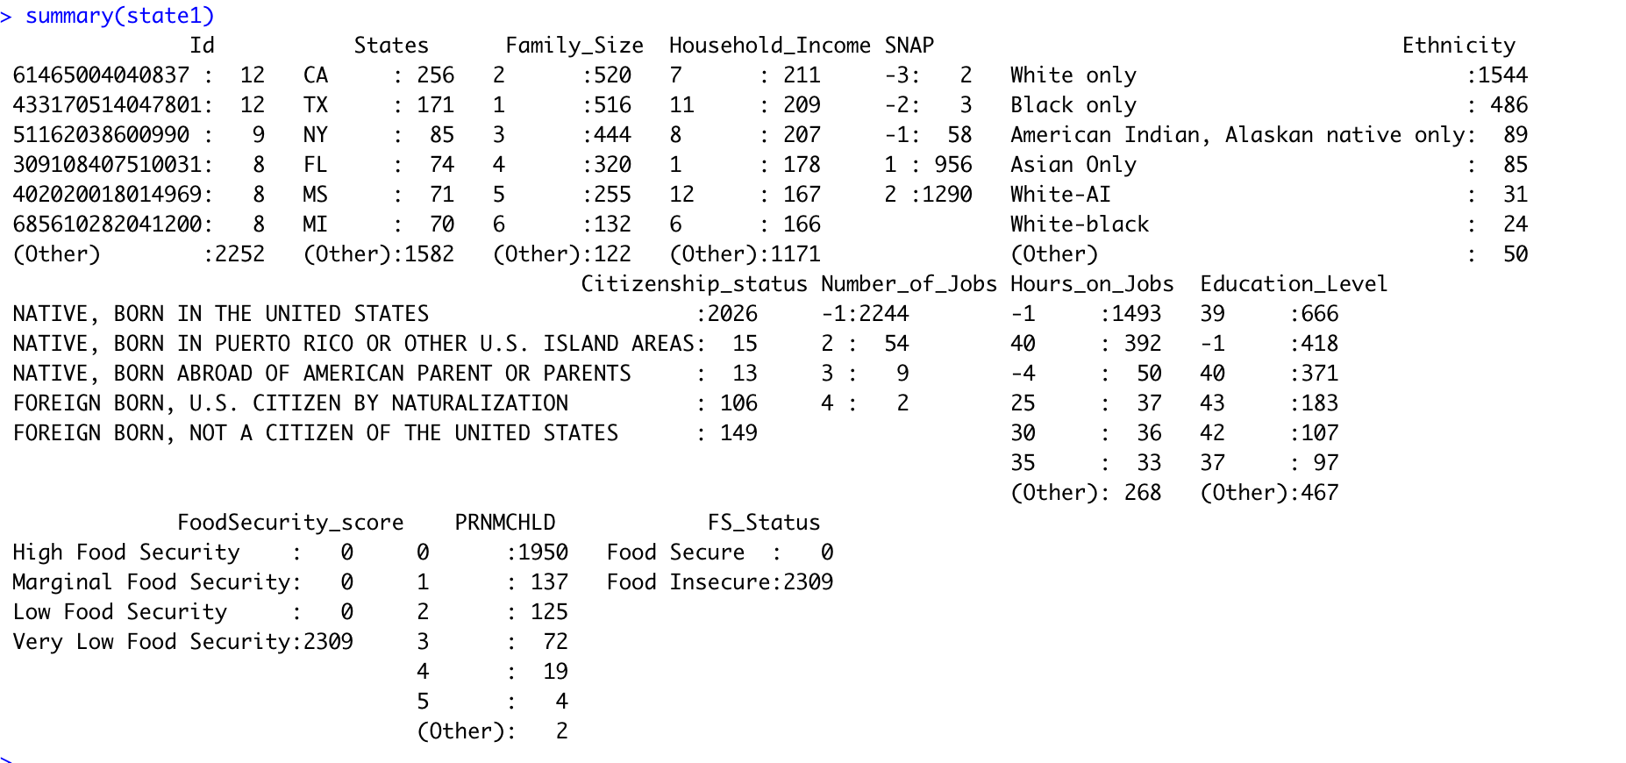

Slide 19
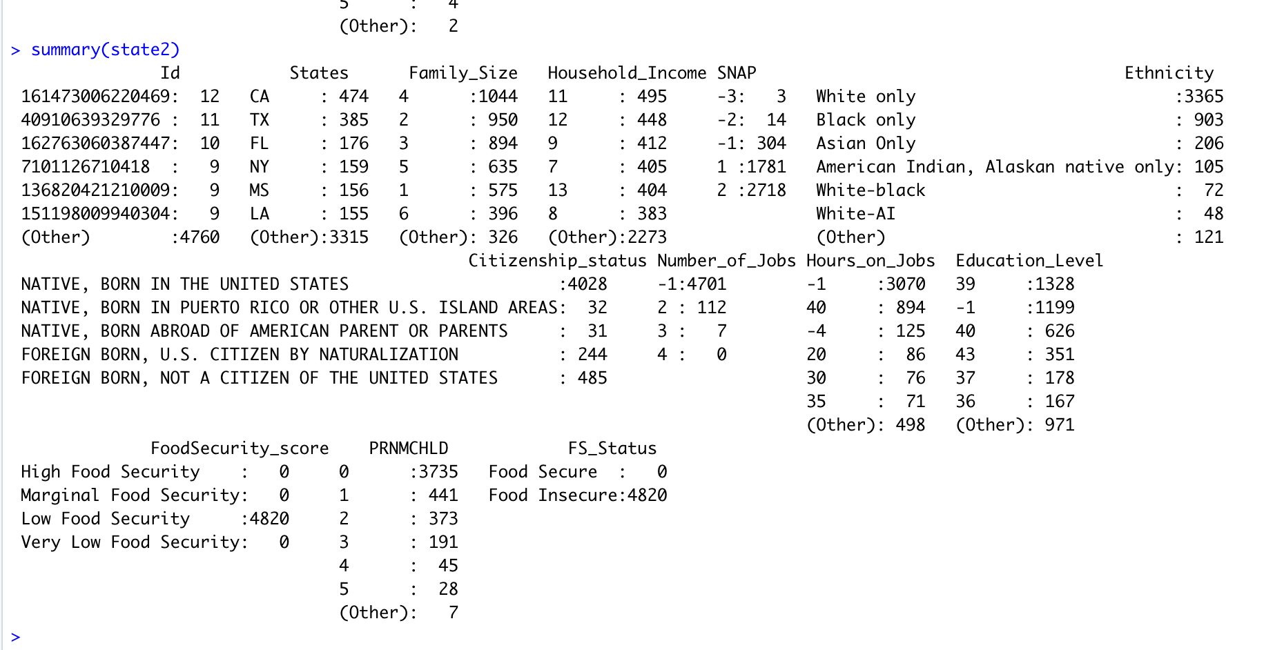

Slide 20
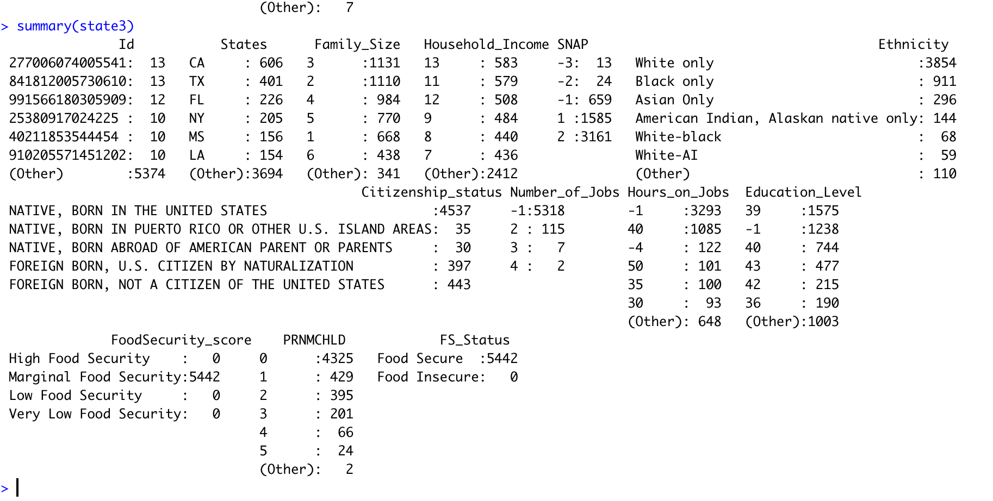

Slide 21
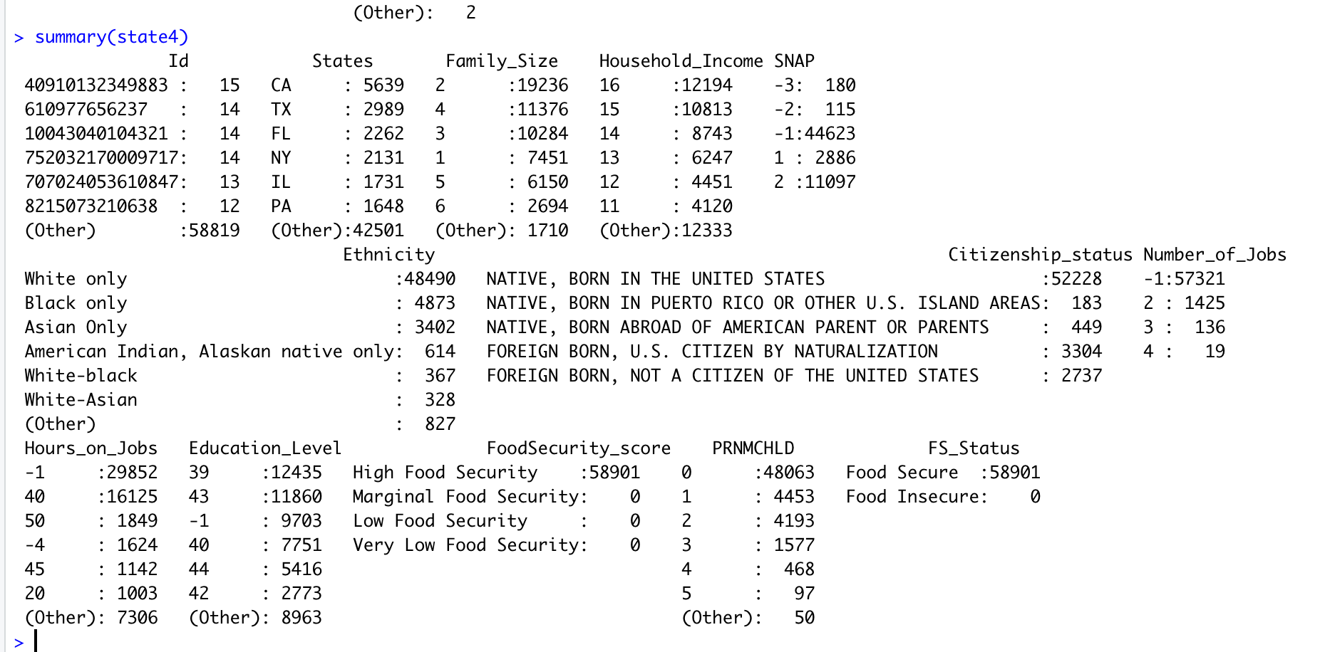

Slide 22
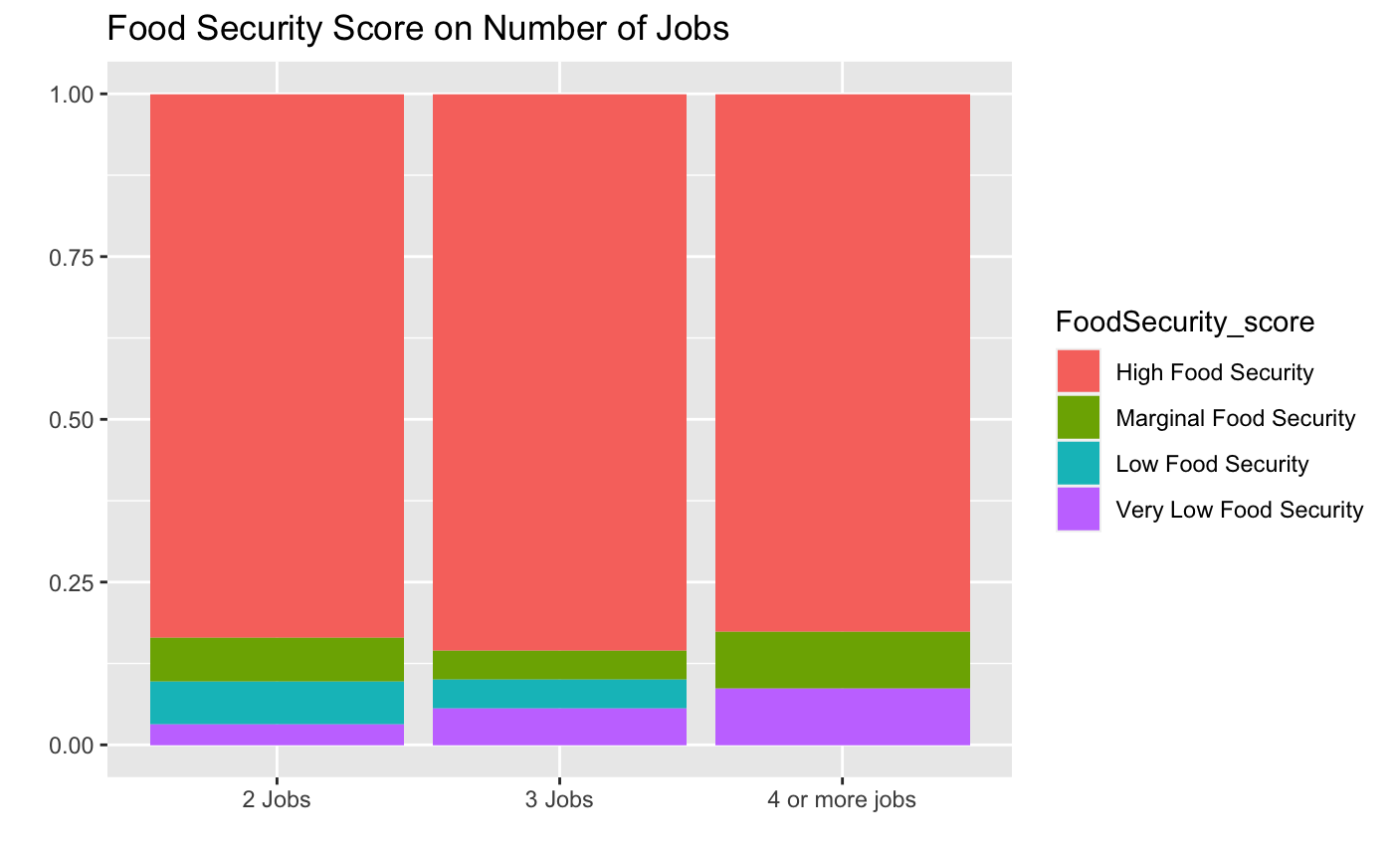
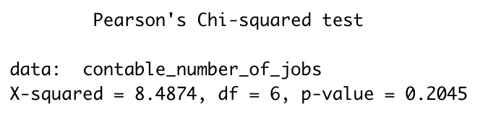
Number of Jobs Vs Food Security
High number of food secure people in all categories
Category of people with more number of jobs - highest number of very low food security.
No. of jobs has no significant effect on the food security score - Chi-Square test results.

Slide 23
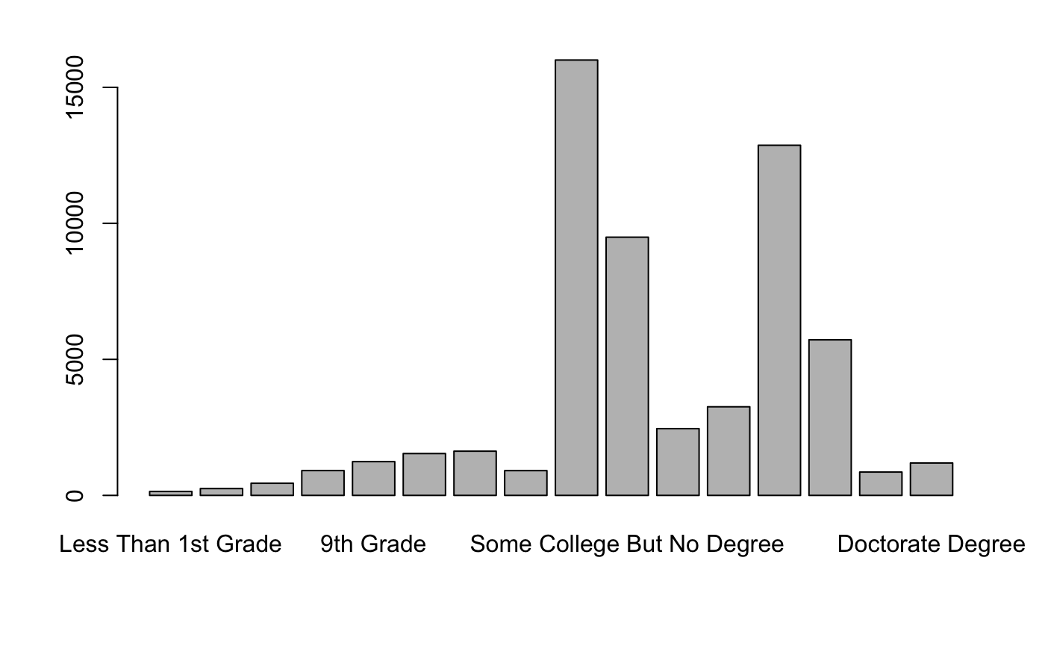
Education Level of Respondents

Slide 24
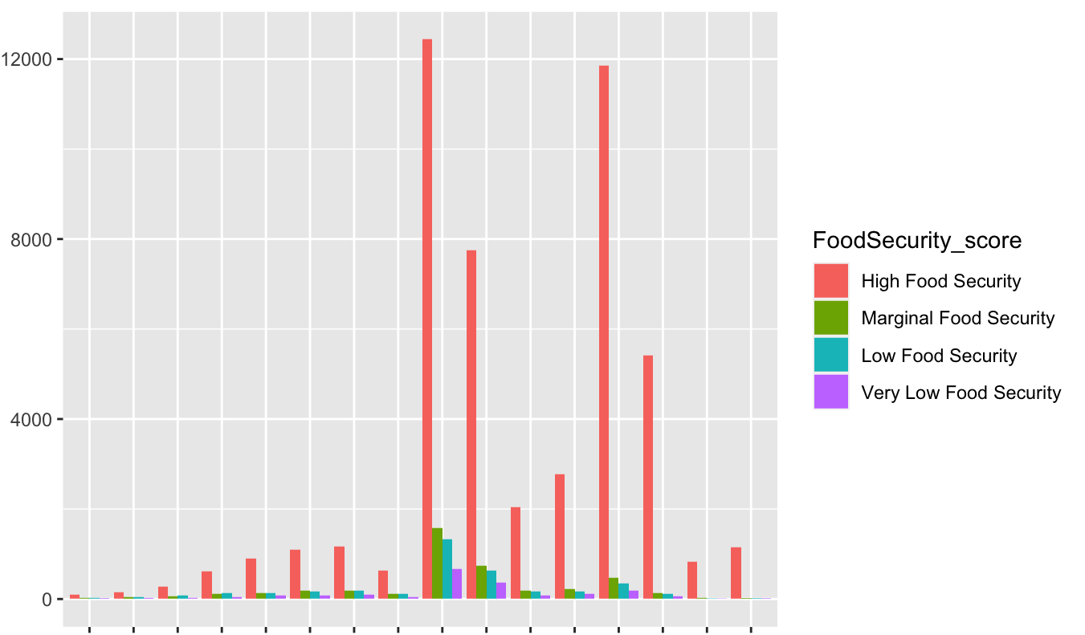
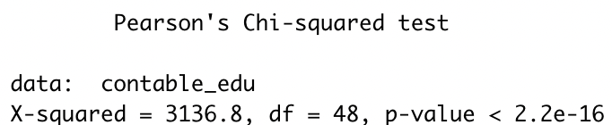
Education Level Vs Food Security
Majority of the respondents are educated till college or more
Major proportion says high food security, but few shows evident responses of low food security.
Chi-square test validates - Education has a significant effect on the food security score

Slide 25
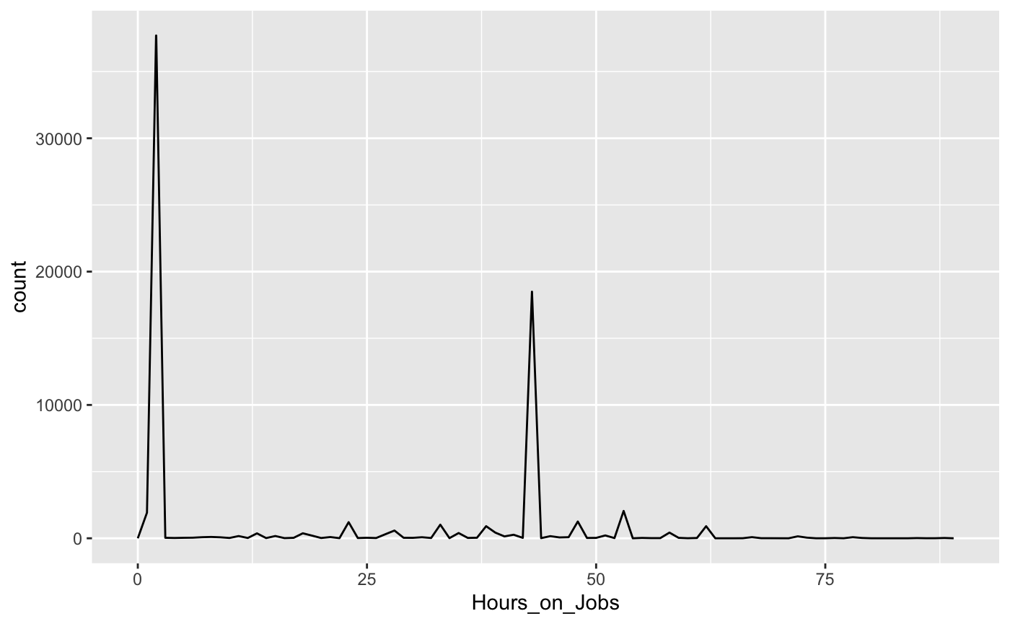
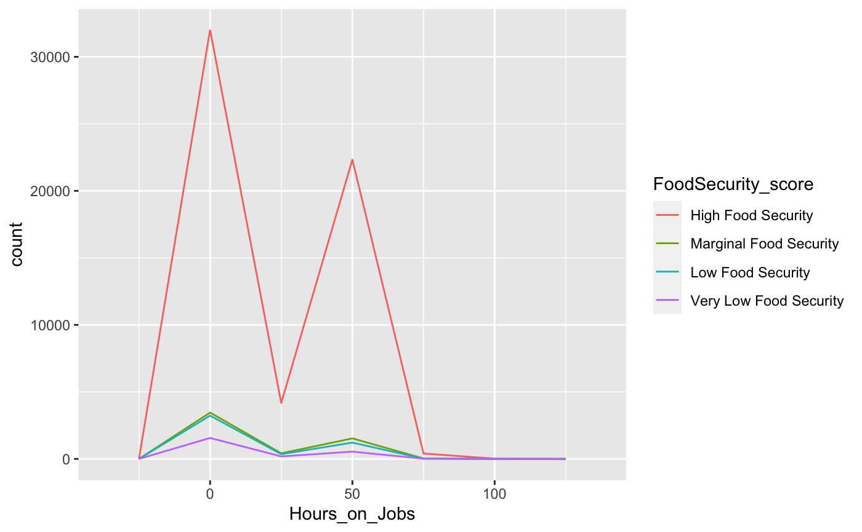

Hours on Job Vs Food Security

Slide 26
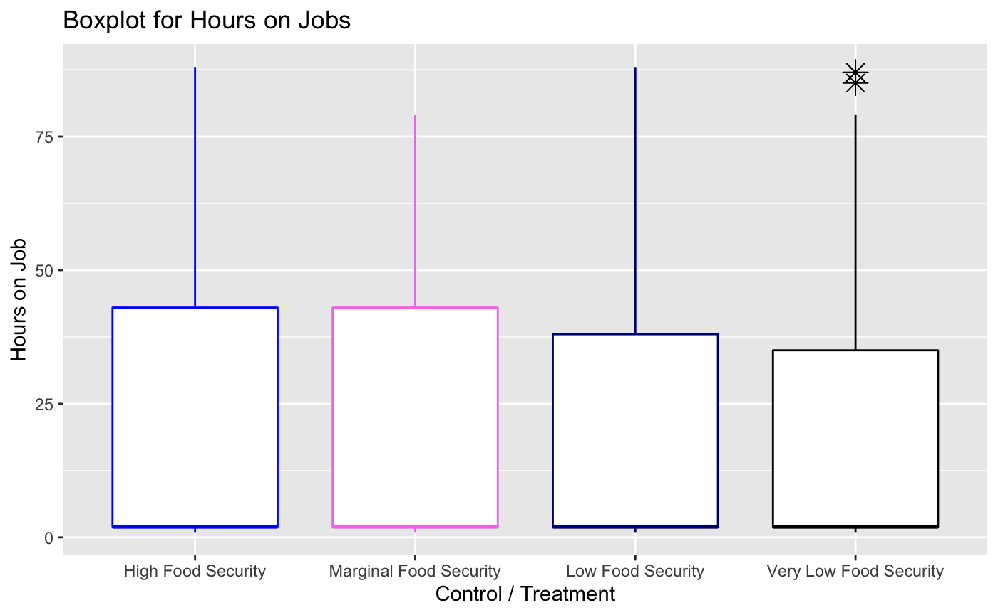
Food Security and Hours of Working
Most of them work for 2 hours.
Box plot shows a difference in range of Hours of job for High food security and Very low food security.

Slide 27
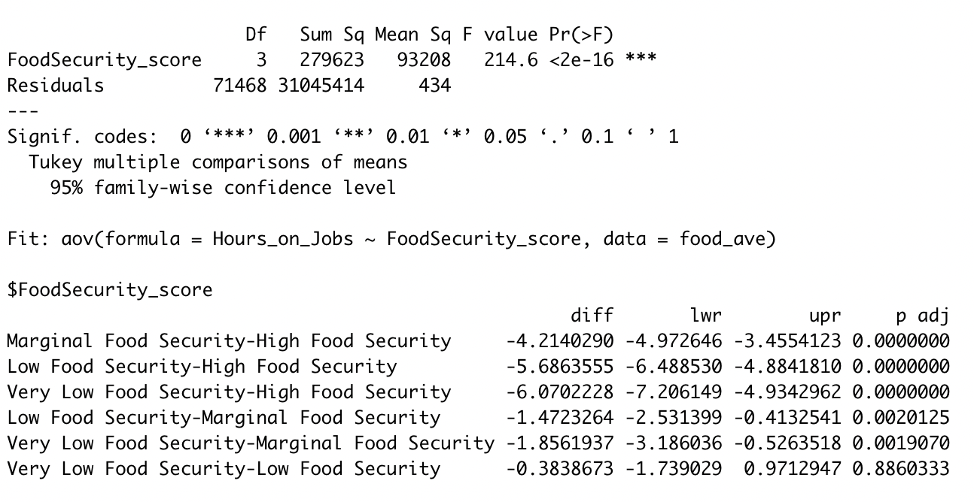
Testing for significant difference in the hours of work among people in different food security level
There is significant difference in the hours of work among
HFS:MFS
HFS:LFS
HFS:VLFS
MFS:LFS
MFS:VLFS

Slide 28
Conclusion & Further Scope of Study
Ethnicity, Citizenship, participation in SNAP, Education level, Hours on work, Household income, Family size have significant relation with the Food Security Score
States - difficult to say that there is a relation between states and Food security score
Further analysis can come up with models to predict the food security score and hence it reveals the important sectors that officials should focus on in order to eradicate food insecurity.

